Slide 1

Health Datapalooza
Mini Summits IV: Payer – How States and Others Are Using Medicare Data to Manage Populations
May 10, 2016
Mylia Christensen, Executive Director

Slide 2

About Us
Independent, nonprofit organization, neutral, independent, multi-stakeholder collaboration
Dedicated to improving the quality and affordability of health care in Oregon
Celebrated our 15th anniversary
1

Slide 3

Q Corp Partnership
Health Plans
Consumers
Providers
Employers
Policymakers
Content Experts & QI Professionals
Delivery System Executives & Managers
Hospitals
2

Slide 4
Q Corp Key Strategies
Leading Community Collaborations
Q Corp will expand its unique role as an independent multi-stakeholder organization to lead community-based initiatives focused on improving the quality and affordability of health care in Oregon. This work includes convening stakeholders and experts around quality and cost issues, aligning efforts to address those issues and conceptualizing and instructing programs using unbiased data and analytics.
Providing Unbiased Quality and Utilization Information
Q Corp will continue to build on its strength as an independent organization that brings stakeholders together to produce transparent data and analytics on health care quality and utilization in Oregon that are actionable by our community to improve health care.
Enhancing and Expanding Data and Analytics
Q Corp will become a trusted community resource for unbiased health care information by expanding its capacity to produce data and analytics that address the rapidly changing state and federal environment.
3

Slide 5
Q Corp Leadership in National Initiatives
Aligning Forces for Quality (Robert Wood Johnson Foundation)
Chartered Value Exchange (Agency for Healthcare Research and Quality)
Network for Regional Healthcare Improvement (NRHI)
CMS Qualified Entity – one of first three recognized in the country
4

Slide 6
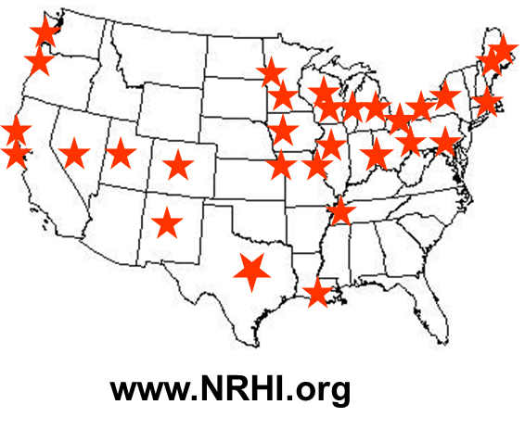
NRHI: Leading Regional Health Improvement Collaboratives
Aligning Forces for Quality – South Central PA | Health Insight New Mexico | Kansas City Quality Improvement Consortium | Minnesota Community Measurement | Washington Health Alliance
Alliance for Health | Health Insight Nevada | Kentuckiana Health Collaborative | North Texas Accountable Healthcare Partnership | Wisconsin Collaborative for Healthcare Quality
Better Health Partnership | Health Insight Utah | Louisiana Health Care Quality Forum | New Jersey Health Care Quality Institute | Wisconsin Health Information Organization
California Quality Collaborative | HealtheConnections | Maine Health Management Coalition | Oregon Health Care Quality Corporation
Center for Improving Value in Health Care (Colorado) | Healthcare Collaborative of Greater Columbus | Maine Quality Counts | Pacific Business Group on Health
Common Table Health Alliance | Institute for Clinical Systems Improvement | Massachusetts Health Quality Partners | P² Collaborative of Western New York
Finger Lakes Health Systems Agency | Integrated Healthcare Association | Michigan Center for Clinical Systems Improvement | Pittsburgh Regional Health Initiative
Greater Detroit Area Health Council | Iowa Healthcare Collaborative | Midwest Health Initiative | The Health Collaborative
5

Slide 7
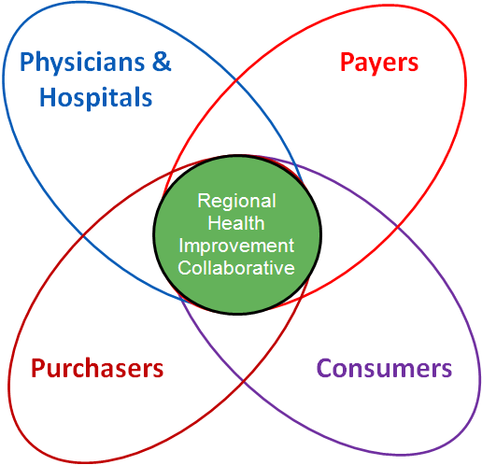
What is a Regional Health Improvement Collaborative (RHIC)?
Nonprofit organization working to improve healthcare quality and value in a specific geographic region through a collaborative effort of all healthcare stakeholders
  Providers
  Purchasers
  Payers
  Patients
6

Slide 8

…and Work Collaboratively With Federal/National Organizations
Regional
Health Improvement
Collaborative
Federal
Agencies
Regional
Health Improvement
Collaborative
Regional
Health Improvement
Collaborative
National
Stakeholder
Groups
NRHI
Regional
Health Improvement
Collaborative
Regional
Health Improvement
Collaborative
National
Foundations
Regional
Health Improvement
Collaborative
7

Slide 9
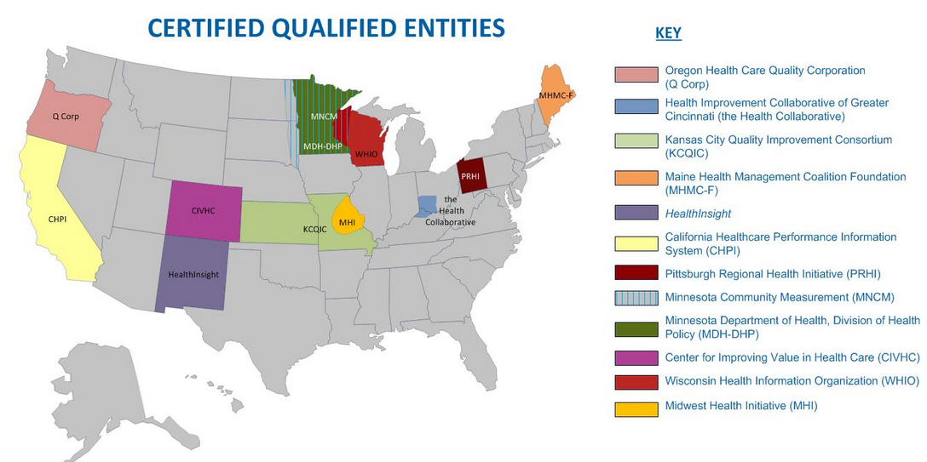
NRHI Members 11 of 13 Qualified Entities
8

Slide 10
Q Corp Voluntary Claims Data Collaborative : 2006-2015
3.5 million unique Oregonians captured in claims 600+ million medical and pharmacy claims records
All providers in the directory are eligible to receive quality reports with patient-level information for follow-up
9

Slide 11
Claims Data Summary: 2006-2015
84% Fully Insured Commercial population
33% Self Insured Commercial population
100% Medicaid population
90% Medicare
  CMS “Qualified Entity” – Incorporated Medicare FFS Data Spring 2014
10

Slide 12
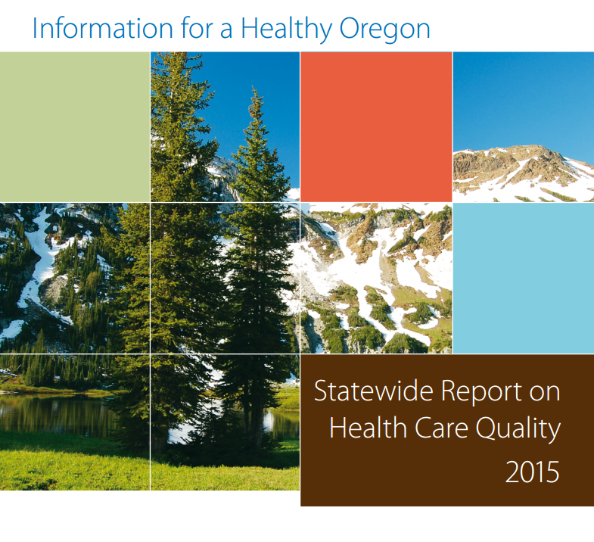
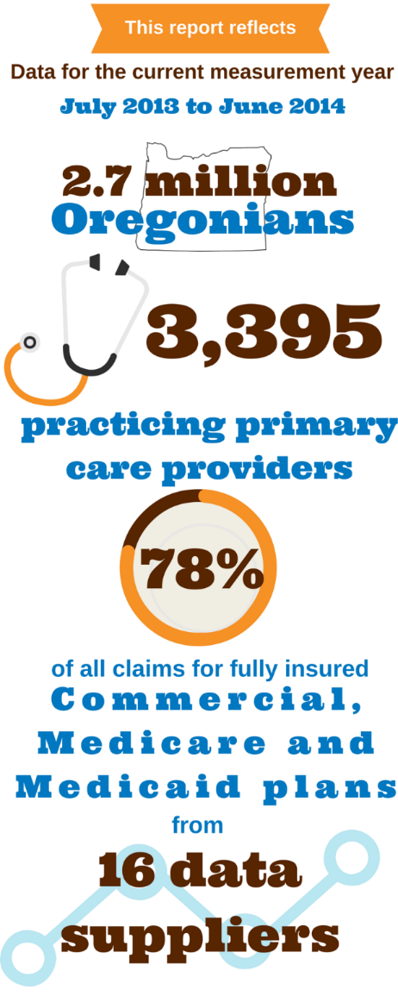
11

Slide 13
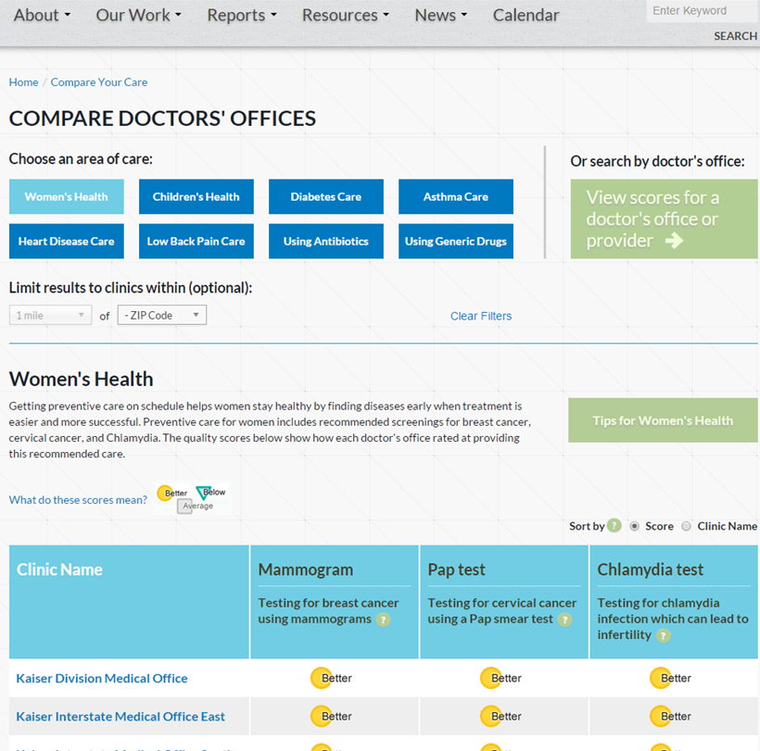
Public Reports: Q Corp Consumer Friendly Website
Improve health care quality in Oregon by providing information to help stakeholders make informed decisions.
Primary care measures include:
  Diabetes Care
  Asthma Care
  Heart Disease Care
  Women’s Preventive Care
  Pediatric Care
  Use of Generic Drugs
  Appropriate Use of Services (low back pain imaging, strep tests for sore throats)
12

Slide 14
Oregon Medicare Fee for Service Enrollment
13

Slide 15
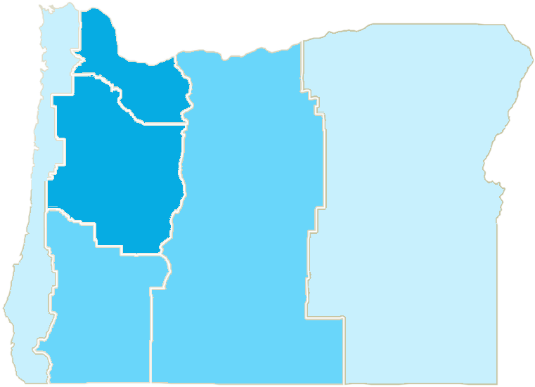
Oregon Medicare Advantage Penetration as of 12/31/15
58%
52%
16%
25%
11%
33%
14

Slide 16
Increased Number of Providers Receiving Reports
Measure report period ending 12/31/2014
15

Slide 17
Medicare Fee for Service members are a distinct demographic
Measure report period ending 12/31/2014
16

Slide 18
Opportunities for Value Based Purchasing
Ability to “see” entire population during multiple regional and national transformation efforts
Quality improvement activities at practice level – sense making
Total Cost of Care measure inclusion
Payment Reform - quality , utilization , cost data
10

Slide 19

Questions?
Contact information:
Mylia Christensen, Executive Director
Oregon Health Care Quality Corporation
mylia.christensen@q-corp.org

